Slide 1
Circuit Implementation Impact on Internal-Nodes Power Attack
Reut Caspi & Moriah Stern
Advisors: Dr. Osnat Keren & Mr. Itamar Levi

Slide 2
Motivation
plaintext
Cryptographic module
ciphertext
Cryptography is the science of transferring
information in a secure way.
The effort needed to logically break the AES algorithm is the
same as the brute-force attack:
2¹²⁸ = 340,282,366,920,938,463,463,374,607,431,768,211,456
Side channel information is any information that is not obtained from the communication interface, such as the power-supply current dissipation.
By utilizing this information an attacker can find secret key very fast (and cheaply).
secret key

Slide 3
Objectives
Where most research is focused
(known crypto architecture)
What we are researching
Objective:
Finding ways to reduce the information that leaks from the combinational part.
Approach– comparing architectures with different:
Fan-out
Symmetric/Asymmetric design
Notes:
Fan-out – Trying to construct architecture with as balanced fan-outs as possible.
Symmetric/Asymmetric design – Restricting the synthesis cell-library to enforce Asymmetric synthesis for crypto modules.

Slide 4
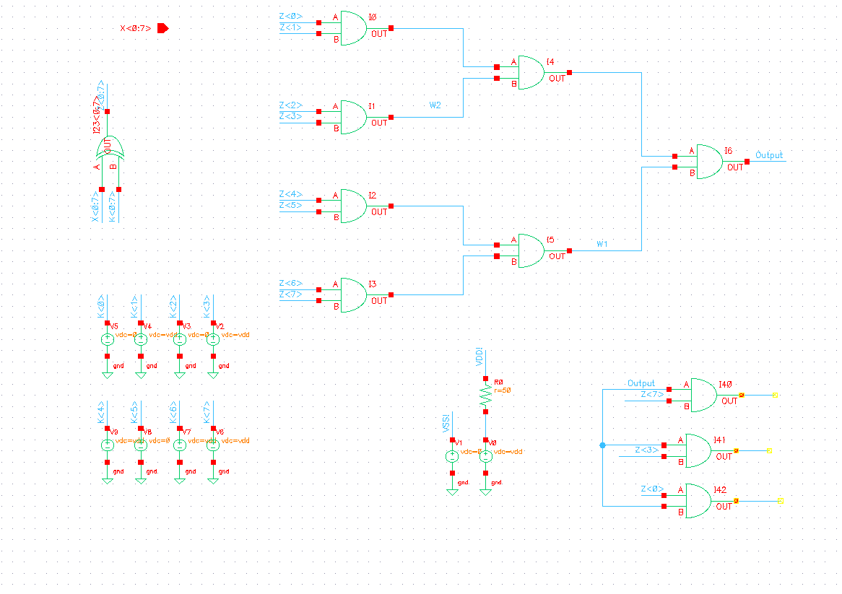
Current status
Literature review
Small scale model:
Implementation (Cadence Virtuoso)
Attacks (Matlab) - ongoing
Preliminary results – matching our hypothesis
Next Steps
Test bench- SBOX:
Synthesis (Cadence Encounter RTL ) - ongoing
Truth tables (Verilog and SimVision)
Attacks (Matlab & Cadence Virtuoso)
Analysis of test bench
Analytical analysis
Research additional properties

