Slide 1
On The Feasibility of Internal-Nodes Power Analysis
Reut Caspi & Moriah Stern
Academic Advisor: Prof. Alexander Fish, Dr. Osnat Keren
Advisor: Mr. Itamar Levi

Slide 2
Outline
Motivation
Background
Project Objective
Results
Further Research
Conclusions
Power analysis
Small Scale Model
Real Life Model

Slide 3

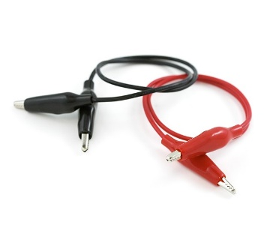
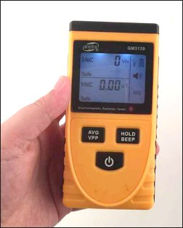



Motivation
Motivation
Background
Project Objective
Results
Further Research
Conclusions
plaintext
Cryptographic module
ciphertext
Cryptography is the science of transferring
information in a secure way.
  The effort needed to logically break the AES algorithm is the
  same as the brute-force attack ($2^{n}$).
Side channel information is any information that is not obtained from the communication interface, such as the power-supply current dissipation.
By utilizing this information an attacker can find secret key very fast (and cheaply).
secret key

Slide 4
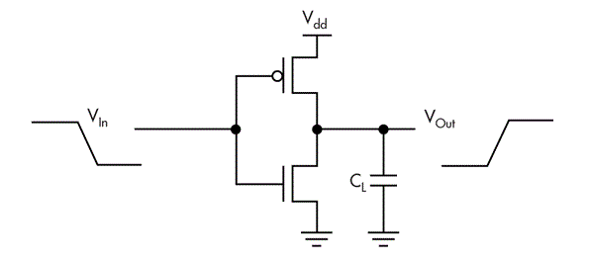
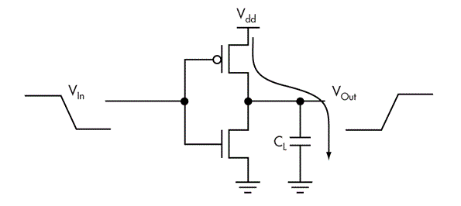
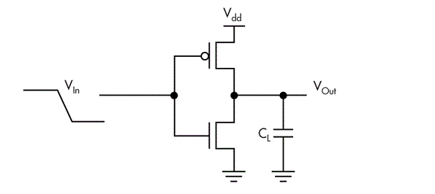

Power Analysis Attacks
Power Attack Procedure:
Motivation
Background
Project Objective
Results
Further Research
Conclusions
Create a hypothesis of the different currents according to different keys
$$I^{hypothesis}=HW∙HD$$

Slide 5

Power Attack Procedure:
Motivation
Background
Project Objective
Results
Further Research
Conclusions
Calculate the correlation between the hypothesis current of each key and the measured current.
The hypothesis that yields the largest correlation is most likely of the correct key.
Measurement
Hypothesis
Key ranking
(SNR)
5
Notes:
SNR גבוה:
זה המפתח הנכון!

Slide 6
Objectives
Motivation
Background
Project Objective
Results
Further Research
Conclusions
What we are researching
Where most research is focused
(known crypto architecture)
Objective:
  Finding ways to reduce the information that leaks from the combinational part.
  To explore if it is feasible to attack internal nodes? Under which parameters?
Parameters to examine:
  Fan-out
  Symmetric / Asymmetric design
  Logic Structure
  Noise – Dependent / Independent

Slide 7
Small Scale Model
Results
Motivation
Background
Project Objective
Small Scale
Real Life
Further Research
Conclusions
A simple module was designed in order to illustrate specific physical-phenomena-related trends we believe exist.
Additional circuitry was added to assure the attack is that of an inner node.

Slide 8
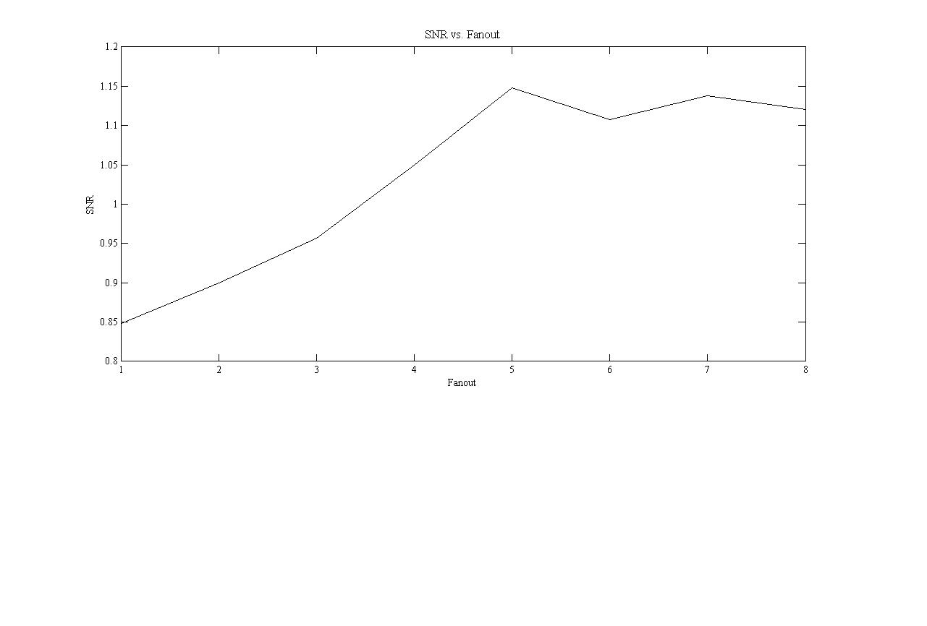


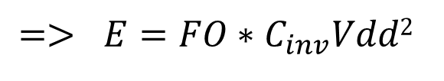
Fan-Out
Results
Motivation
Background
Project Objective
Small Scale
Real Life
Further Research
Conclusions
Larger load capacitance -> energy increase
The capacitance is simplified to be linear with the fan-out.
$E=C_{load}∗{Vdd}^{2}$
$$Cload = FO∗Cinv$$
Increased PA sensitivity
$$=> E=FO∗C_{inv}Vdd2$$

Slide 9
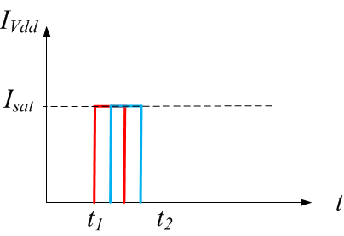
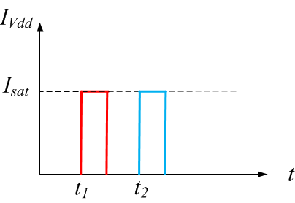

Asymmetry
Results
Motivation
Background
Project Objective
Small Scale
Real Life
Further Research
Conclusions
Symmetric design - delay balanced through all-paths.
Asymmetric design - different delays on different paths.
An attack succeeds when different computations leak information at the same time.
As the asymmetry increases it is harder to capture such samples.

Slide 10
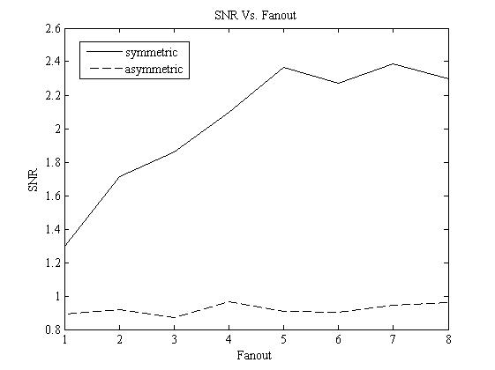
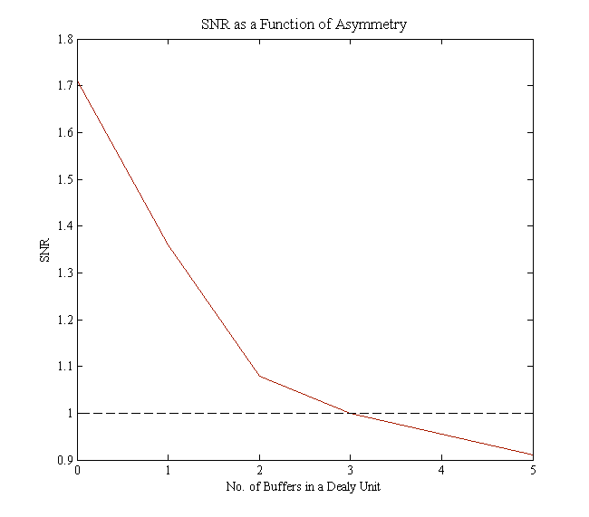

Results
Motivation
Background
Project Objective
Small Scale
Real Life
Further Research
Conclusions
Asymmetry
symmetric
asymmetric

Slide 11
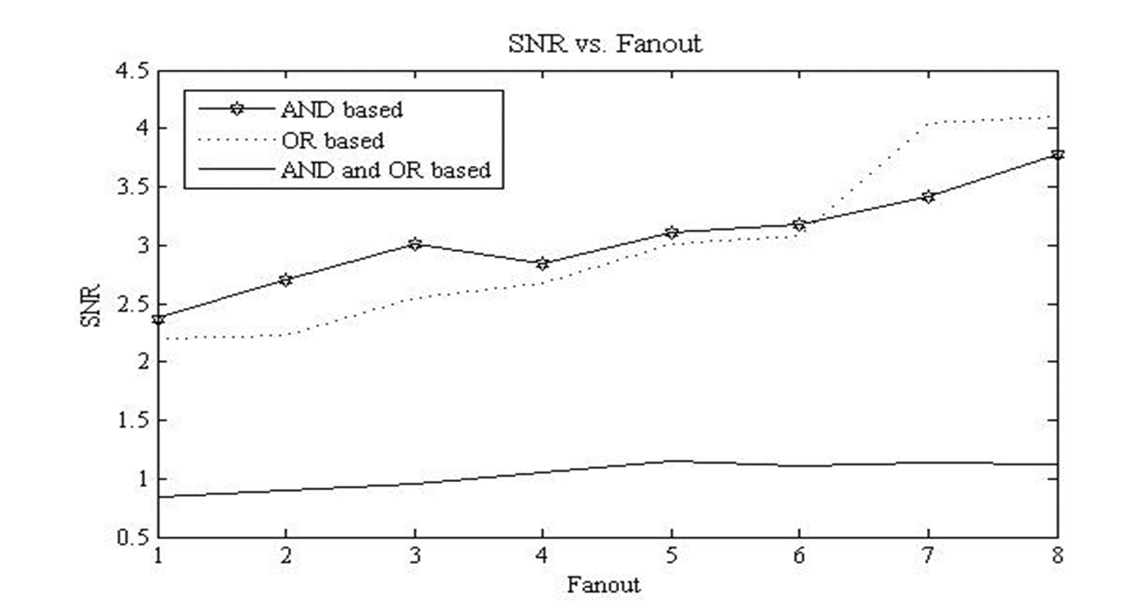
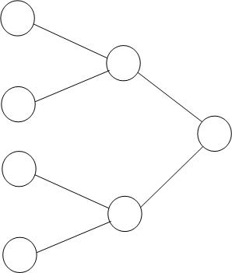
Results
Motivation
Background
Project Objective
Small Scale
Real Life
Further Research
Conclusions
Logical Structure
The logical structure implies correlations between intermediate computations.
Designs constructed with only AND or only OR based gates are highly sensitive.
and
or
50% and – 50% or

Slide 12
Current Components
Results
Motivation
Background
Project Objective
Small Scale
Real Life
Further Research
Conclusions
current we are interested in measuring
“undesired” components:
  independent of the data - easily filtered out when given enough statistics
  data dependent - cannot be completely filtered
Data dependent current is very prominent when discussing inner nodes.
Correctly designed it can enhance the immunity to PA attacks.

Slide 13
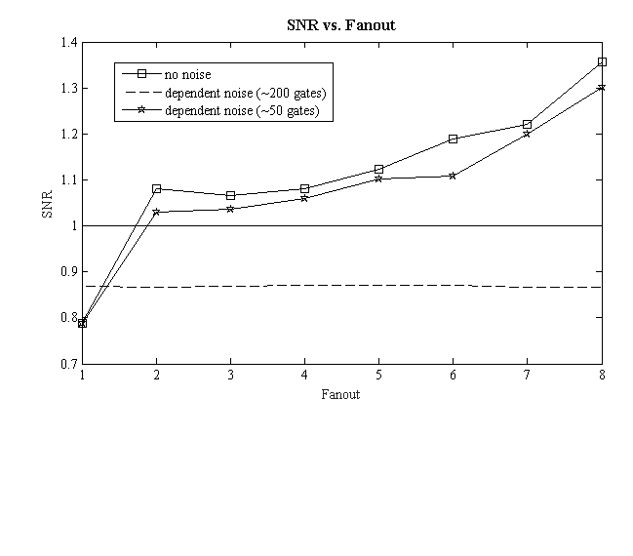
Current Components
Results
Motivation
Background
Project Objective
Small Scale
Real Life
Further Research
Conclusions
Data-dependent
noise
no noise
noisy ~50 gates
noisy ~200 gates

Slide 14
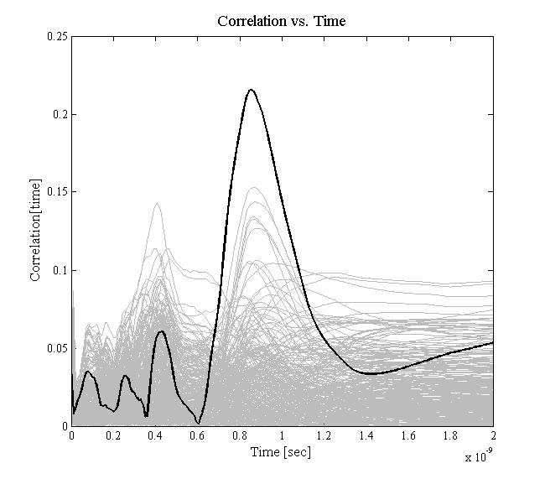
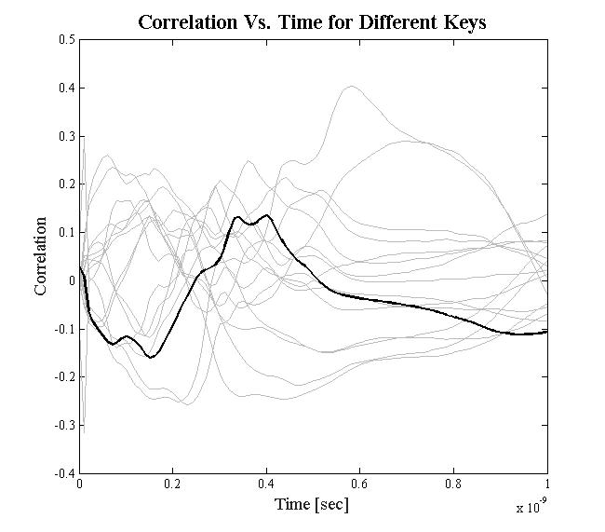
Attackability
Results
Motivation
Background
Project Objective
Small Scale
Real Life
Further Research
Conclusions
attackable
not attackable

Slide 15
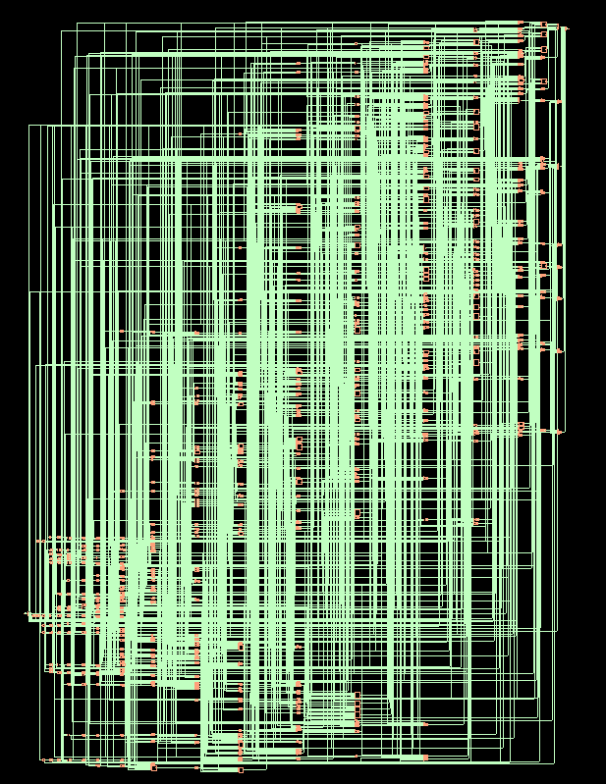
Cost of Fan-Out
Results
Motivation
Background
Project Objective
Small Scale
Real Life
Further Research
Conclusions
Implementations were synthesized with Cadence Encounter RTL
Design constraints were used to achieve the desired designs.
Design | FO2 | FO3 | FO4 | FO5 | FO6 | FO7 | FO8
Total No. of Nodes | 859 | 763 | 684 | 637 | 602 | 555 | 547
Area\Energy …

Slide 16
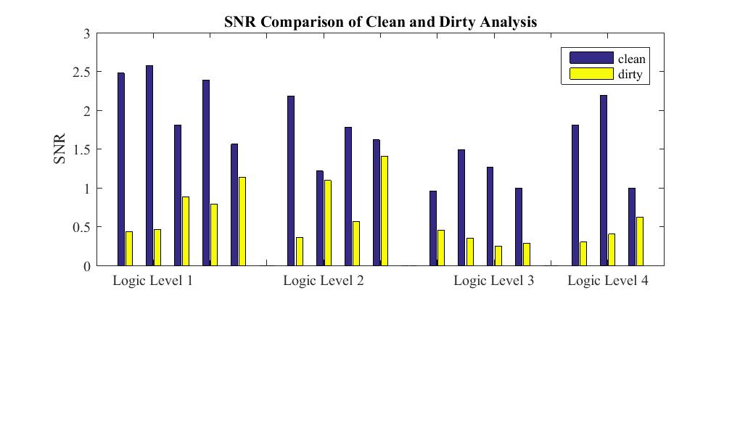
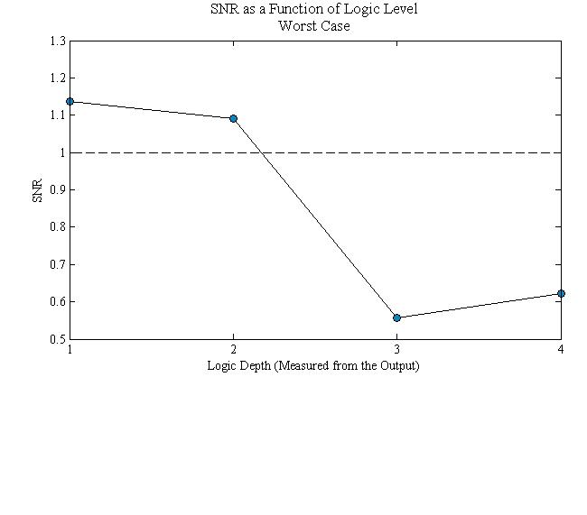
Data dependent currents
Results
Motivation
Background
Project Objective
Small Scale
Real Life
Further Research
Conclusions
distance from the output increases
-> data-dependent “noise” increases (more inner)
-> vulnerability to PA attack increases

Slide 17

Future Research
Motivation
Background
Project Objective
Results
Future Research
Conclusions
Inner nodes are likely to only be dependent on part of the input.
Hypothesis functions must be created for sub-keys to remove unwanted noise.
Example:
$$f\left(x_{1},…x_{8},k_{1},…k_{8}\right)=$$
$$\left(x_{1}⊕k_{1}\right)∗\overline{\left(x_{2}⊕k_{2}\right)}∗\left(x_{3}⊕k_{3}\right)∗\left(x_{4}⊕k_{4}\right)$$

Slide 18
Conclusions
Motivation
Background
Project Objective
Results
Future Research
Conclusions
Is power analysis feasible in inner nodes?
YES!
Sometimes…
What effects the feasibility / quality of an attack?
fan-out
asymmetry
noise
logic structure
etc.
What is the cost?
enhanced security
larger no. of gates
larger area

Slide 19

Thank You!

