Slide 1
Advanced Network Labs & Remote Network Agent
Asaf Avisar
Evyatar Shalev

Slide 2
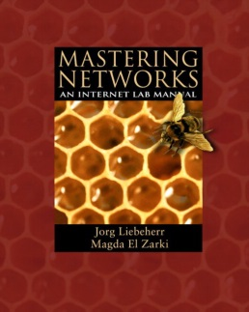
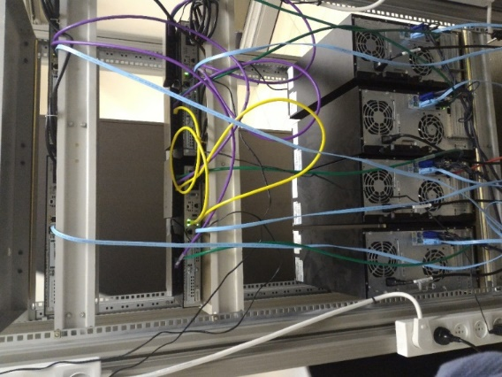
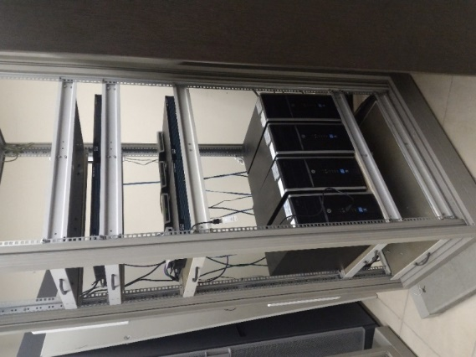
Objective #1
Conducting labs with “ Mastering Networks “ manual, and adapt it to our network equipment.
Notes:
Local network security today relay on a Firewall connected at the entrance of a network which inspect every packet pass through it.
Security in networks based on the assumption that once a computer is inside my personal network (“physically connected”) it is less dangerous to it.
Therefore, most of private networks today are vulnerable from “inside”.
We will use this vulnerability, by opening a “back door” to a network which will act like a host in the network while actually pass back and forward packets from another network.
By doing so, We have straight access through an unauthorized gate to any computer in a private network.

Slide 3
Implementation- Labs
The labs manual consists of 10 labs that deal with main network topics.
Lab | Topic
1 | Introduction
2 | Single segment IP networks
3 | Static Routing
4 | Dynamic Routing Protocols
5 | Transport Layer Protocols
6 | LAN Switching
7 | NAT and DHCP
8 | DNS
9 | SNMP
10 | IP Multicast

Slide 4
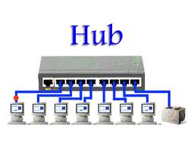
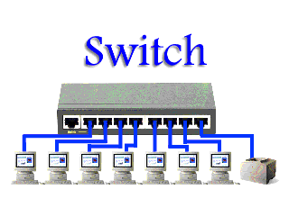
Implementation- Labs
The manual was written in 2005, therefore, it is optimized to the software and hardware that were popular then.
In order to run it on a modern setup, a lot of adaptations had to be made, especially with Linux commands, networking tools and more.
All the adaptations are documented in a dedicated guide.

Slide 5
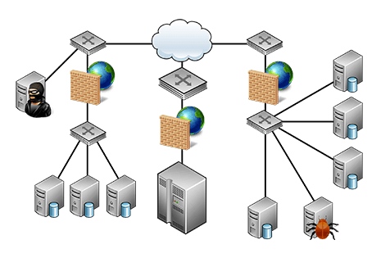
Objective #2
Remote Network Agent – sophisticated “ back door ” to a network.
Basic assumptions :
Local network security today relies on a Firewall.
Most private networks today are vulnerable from the “inside”.
Notes:
Local network security today relay on a Firewall connected at the entrance of a network which inspect every packet pass through it.
Security in networks based on the assumption that once a computer is inside my personal network (“physically connected”) it is less dangerous to it.
Therefore, most of private networks today are vulnerable from “inside”.
We will use this vulnerability, by opening a “back door” to a network which will act like a host in the network while actually pass back and forward packets from another network.
By doing so, We have straight access through an unauthorized gate to any computer in a private network.

Slide 6
Remote Network Agent
Intervening NAT normal operation in order to impersonate a host in a secured network from distant location.
Implementation involves multiple protocols :
NAT- Network Address Translation.
Port forwarding.
VPN- Virtual Private Network.
Notes:
NAT – Network Address Translation which changes IP & ports for expending availability of IP addresses.
Port forwarding – Protocol in use in routing for moving packet to a pc according to the port assign to it.
VPN - Virtual private network which connect a pc to a private network even if its not locally there.

Slide 7
Remote Network Agent
Modifying external packet’s headers to act as internal ones.
The logic of changing the header runs on a malicious host and managed with Data Base.
An operator controls the Data Base with a friendly web/Python based GUI.
Application
Application
Presentation
Presentation
Session
Session
Transport
Transport
Malicious header
Network
Network
Data link
Data link
Physical
Physical

Slide 8
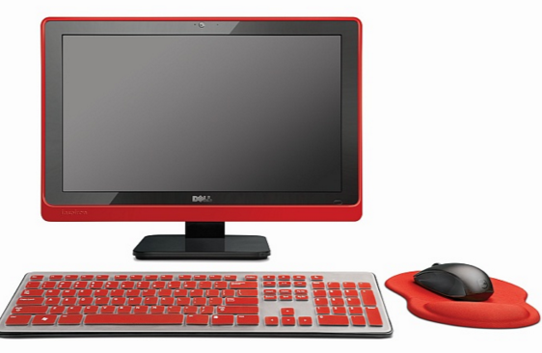
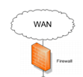
Demonstration
Basic attack
Operator
DstIP: Agent p: 10000
SourcIP: Operator
Blocked by Firewall
Firewall
Local network
victim1

Slide 9
Demonstration
Remote Network Agent
attack
Operator
DstIP: Agent p: 10000
SourcIP: Operator
Firewall
Agent
Local network
Eth0
Cell0
victim1

Slide 10
Demonstration
Remote Network Agent
attack
Operator
Agent DB
outside Port | Inside dest ip | Inside dest port
10000 | Victim1 | 80(http)
20000 | Victim1 | 21(ftp)
30000 | Victim2 | 21(ftp)
Firewall
Agent
Local network
DstIP: Agent p: 10000
SourcIP: Operator
Dst: VICTIM1 P: 80
Source: Agent
Eth0
Cell0
victim1

Slide 11
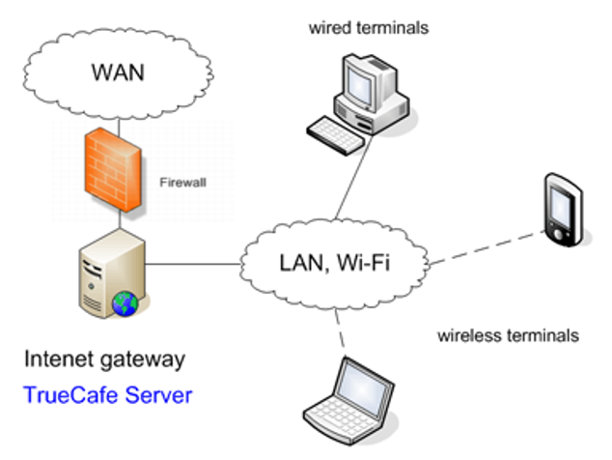
Dst: 212.7.4.4:10000
Source: 213.6.4.3: 4231
10.0.0.3
212.7.4.4
10.0.0.1
213.6.4.3
Dst: 10.0.0.1: 21
Source: 10.0.03: 5123
10.0.0.0
APP
Control links
10.0.0.2
10.0.0.3

Slide 12
Challenges
Learning computer networks infrastructure.
Conducting the labs with an old manual.
Understanding Linux Kernel Networking.
Manipulate sockets with code.
Notes:
Linux Kernel Networking – Linux, in its basic networking capabilities, allows user working with sessions only ( layer 4-7 OSI module). To modify layer 1-3, we need to deeply understand Linux networking kernel structure and alter it according to our project.
Programming – Our code should work with a correspondence to Linux kernel. We have to implement a whole header and do not disturb to Linux kernel stack, while implementing GUI, Remote access and using DB.

