Slide 1
Robocup Motion
Liran Halak
Ori Haluba

Slide 2
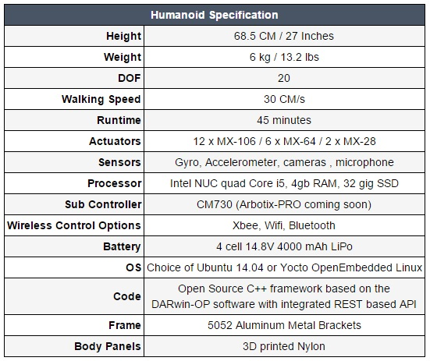
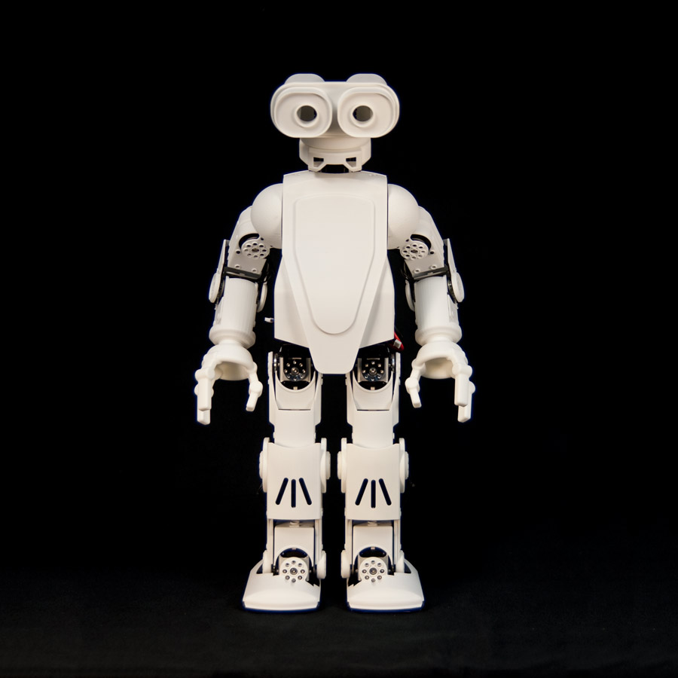
Specs:
HR-OS5 Humanoid Research Robot

Slide 3
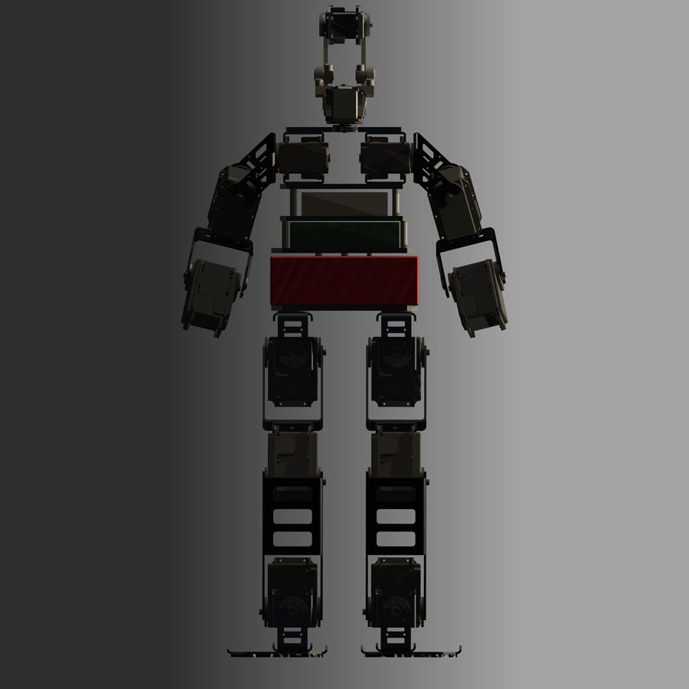
Specs:
Number of degrees of freedom and type of motors on each
kinematic chain of the robot –
The HR-OS5 Humanoid Research Robot uses
the following Dynamixel Servos:
12x MX-106T Dynamixel Actuator
6x MX-64T Dynamixel Actuator
2x MX-28T Dynamixel Actuator
Type of sensors used (incl. type of camera(s)) –
3-axis gyroscope
3- axis accelerometer for posture estimation and balancing.
A camera (Sony ICX424 – 0.3 MP, 84 FPS, resolution 648x488)
Microphones in the head.
Computing unit(s) –
Intel NUC D54250WYB SBC, uses Intel Core i5-4250U
(Haswell 4th generation)
Ubuntu 14.04 LTS Operating System
Subcontroller - Arbotix-Pro/CM-730 ARM subcontroller

Slide 4
Motion
Our main goal until now was to get the robot ready for the Capability Demo video, that was part of our qualification requirements for the 2016 Robocup KSL (Kid Size League) in Germany.
Our focus was the motion part of the robot, mainly:
Walking – Improving existing walking capabilities for more balance and speed
Kicking the ball – Creating a stable kick
Standing up after falling on back\front
Goalkeeper saving the ball
Demo video: https://www.youtube.com/watch?v=13pjU3D0Xk4&feature=youtu.be

