Slide 1
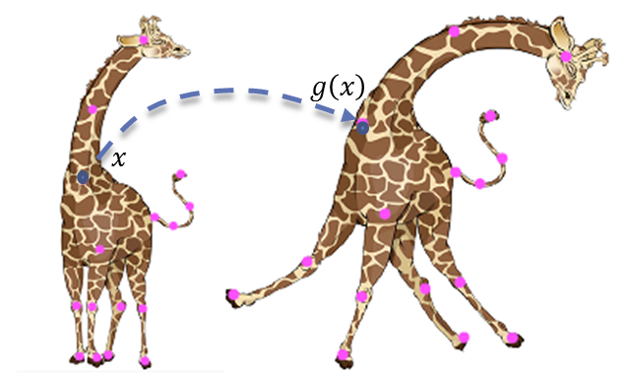
Smooth Bounded Distortion Mappings
Using A Fast Projection Operator
Our Objective
To find a technique for producing visually pleasing planar shape deformations with fast operations
How are shapes deformed in computer graphics?
In order to deform a shape, a planar map is used.
A map is a vector function that changes the coordinates of a point in the plane.
f : U → V with U, V ⊆ ℂ^{n}

Slide 2
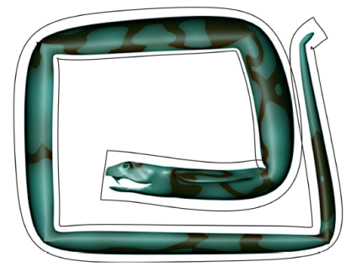
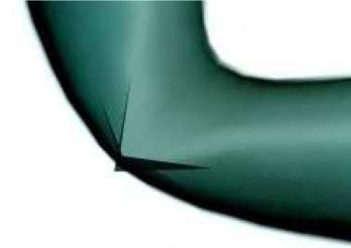
the project
We shall study and implement Dr. Weber’s technique for computing bounded distortion harmonic mappings
We want to turn this
Into this
And not get this
The project will be implemented in c++ and Matlab
Autodesk Maya will be used for graphic visualizations and for creating the user interface
Matlab will be used for linear algebra computations
CVX will be used for solving convex optimization problems

Slide 3
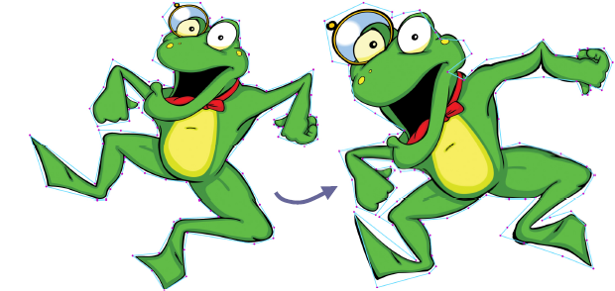
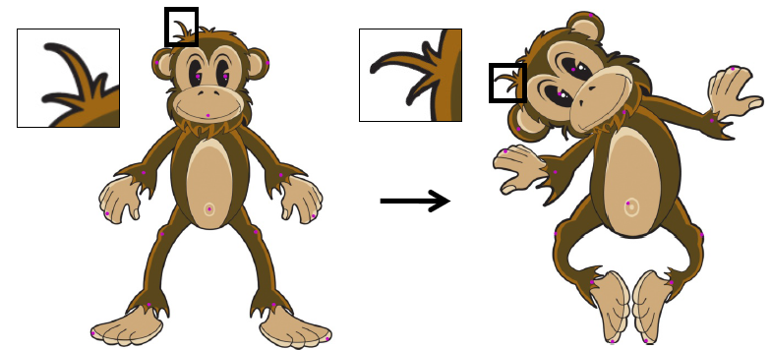
Complex Barycentric Coordinates
with Applications to
Planar Shape Deformation
Ofir Weber, Mirela Ben-Chen and Craig Gotsman
The problem of shape deformation
There is a tradeoff between global changes and local detail preservation
VS
Challenges:
Shape preservation – we would like the overall shape to have bounded distortion
Exact Boundary Behavior – we would like the shape to stay within the control cage
Efficiency – fast computation time
Easy to control

Slide 4
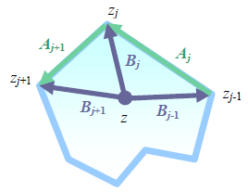
The Solution
We shall use complex barycentric coordinates
Pros:
The resulting function g is holomorphic, and infinitely differentiable
Reproduces similarity transformations
Small extra cost in computational complexity, in pre-process time only
Work well with P2P - An intuitive user interface for the modeler
Cons:
Exact Boundary Behavior – target image may deviate from the cage
Mapping is not injective
Scale distortion is unbounded

