Slide 1
Vision & Image Processing for RoboCup KSL League
Rami Isachar
Lihen Sternfled

Slide 2
Vision module
The Vision module is responsible for image processing. The main goal is to detect meaningful objects - ball, and distance to detected objects. The implementation uses some functions from the OpenCV image processing.

Slide 3
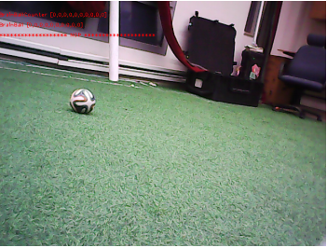
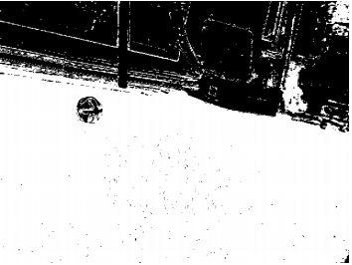
Calibration Tool
Our design contains a separate tool that adjust our image-processing to the current environment colors. The tool ”teaches” the robot how to define the green color spectrum and the white spectrum. The tool shows the user 2 images - the original image and an ”only green”/”only white” image. The user clicks on the green pixels in the original image and the tool colors only these pixels in white in the ”only green”/”only white” image, as can be seen in figure 1. (a) Original Image (b) ”Only Green” Image Figure 1: Calibration-Tool Example
(a) Original Image
(b) ”Only Green” Image

Slide 4
Common Image Processing Techniques
HSV - We prefer to use the HSV(hue,saturation & value) image format over the common RGB format. RGB components of an object’s color in a digital image are all correlated with the amount of light hitting the object ,and therefore with each other. Thus, image descriptions in terms of RGB components make object discrimination difficult. Instead, descriptions in terms of HSV are far more relevant.
Dynamic Threshold - Almost every image processing in our code starts with an ”image segmentation”. This is done in a very simple way, using the threshold method. The threshold uses the values that were calibrated with our calibration tool. By doing this, the threshold varies with every calibration, making it adaptive to a variety of lighting conditions, grass color, etc.
Erosion & Dilation - After thresholding we use Erosion & Dilation to ”fill holes” in the given B&W image. Erosion is done by applying a filter on the image that changes pixel color to white iff all the pixels that surrounds it are white. Dilation does the same action for black pixels. Combining these filters gives us the ability to ”fill holes” and more. Various algorithms have been tested regarding ball, goal and white-lines detection. ultimately we’ve chosen the most efficient one in terms of fast computations and accuracy as described below.

Slide 5
Ball Detection
The ball detection algorithm is based on finding circle shapes in a B&W image. Assuming light conditions are very noisy and therefore unexpected, as well as the colors of the ball are unknown, we have tried to develop an algorithm that is based on the geometry of the object and not on the objects color. We use OpenCV’s Hough transform functions, in particular HoughCircles, to detect circular objects.

Slide 6
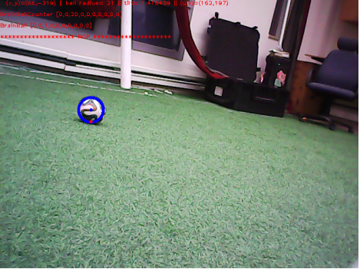
Ball Detection Cont’
we ensure that the founded circular object is located on a green background, in order to eliminate circular objects positioned outside the field. We also take into consideration the fact that the ball is 50% white. We color in white the other 50% non-white pixels (which are inside the ball boundaries) by applying Erosion&Dilation to the B&W image. By doing it we get a perfect circle, which is easier to detect. A ball detection example is presented in figure 2
Figure 2: The robot detects the ball

